Slide 1


GameSAT
Play to learn.

Slide 2

Overall Project

Slide 3

Overall Project
GameSAT is an android app that turns vocabulary learning into a fun game.
GameSAT helps students prepare for the verbal sections of the GRE and SAT exams
Most common words used in the SAT and the GRE exams constitute the game vocabulary.
Question presentation is similar in style to that of the SAT and GRE exams.

Slide 4
The global database allows user Log-In.
The user can play or train.
Store user data in a global database.
Implemented Functionalities

Slide 5
The user can play a word game, or passage game.
The user can train in words or passages.
The user can seek help, from the Help button.
Implemented Functionalities

Slide 6
The user can leave their present state using the Back button.
A leader board of the best play performances is maintained.
In play mode the user can skip questions.
Implemented Functionalities

Slide 7
Missed questions are used in Training Mode.
The user can exit the game using the EXIT button.
Skipped questions are used in Training Mode.
Implemented Functionalities

Slide 8
Implemented Functionalities
150 questions used for the Word game; 111 questions used for the Passage game.
Questions randomly chosen and different consecutive questions presented each time.
In Training Mode missed or skipped questions repeat twice to reinforce learning.
Play Mode has 3 different levels, each increasing in difficulty.

Slide 9

Software Demo

Slide 10
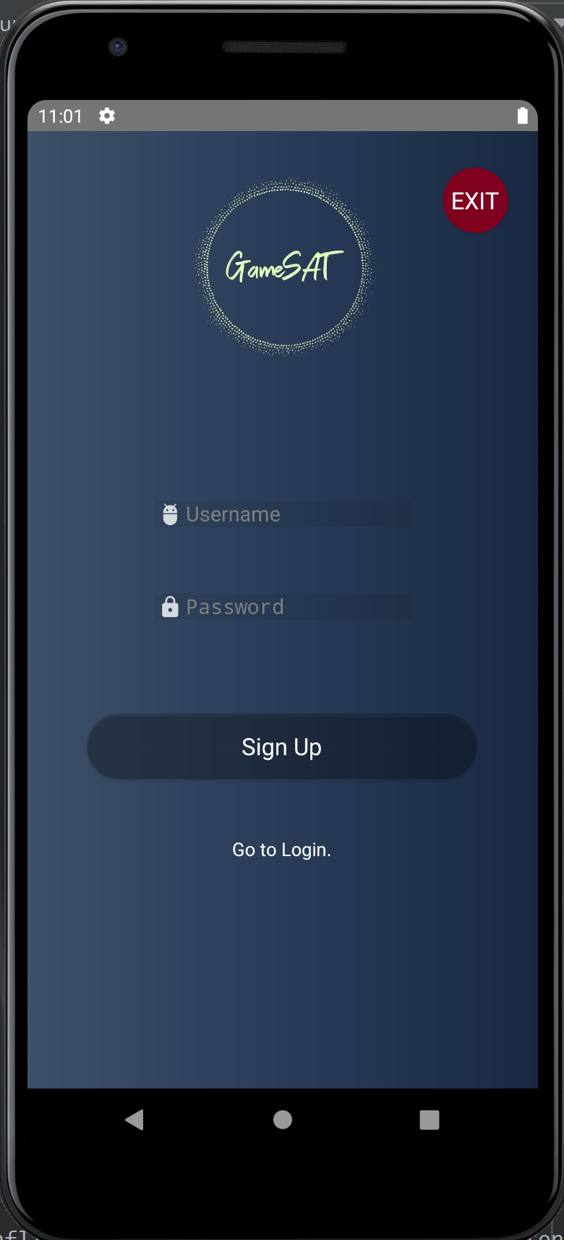
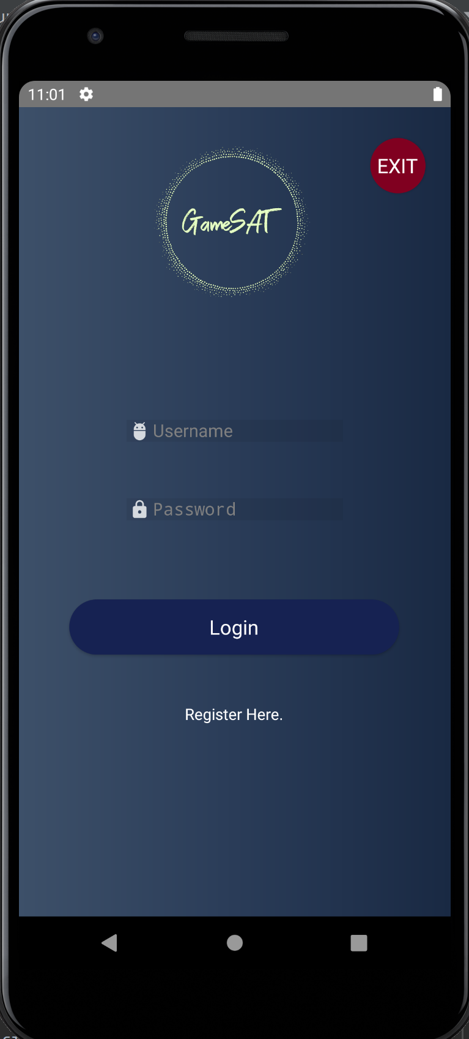

Sign-Up/Log-In
User selects Register Here.
User enters a Username, and a Password and selects Sign Up.
User goes to Login and enters the created Username and Password.
User presses the Login button and enters the game.

Slide 11
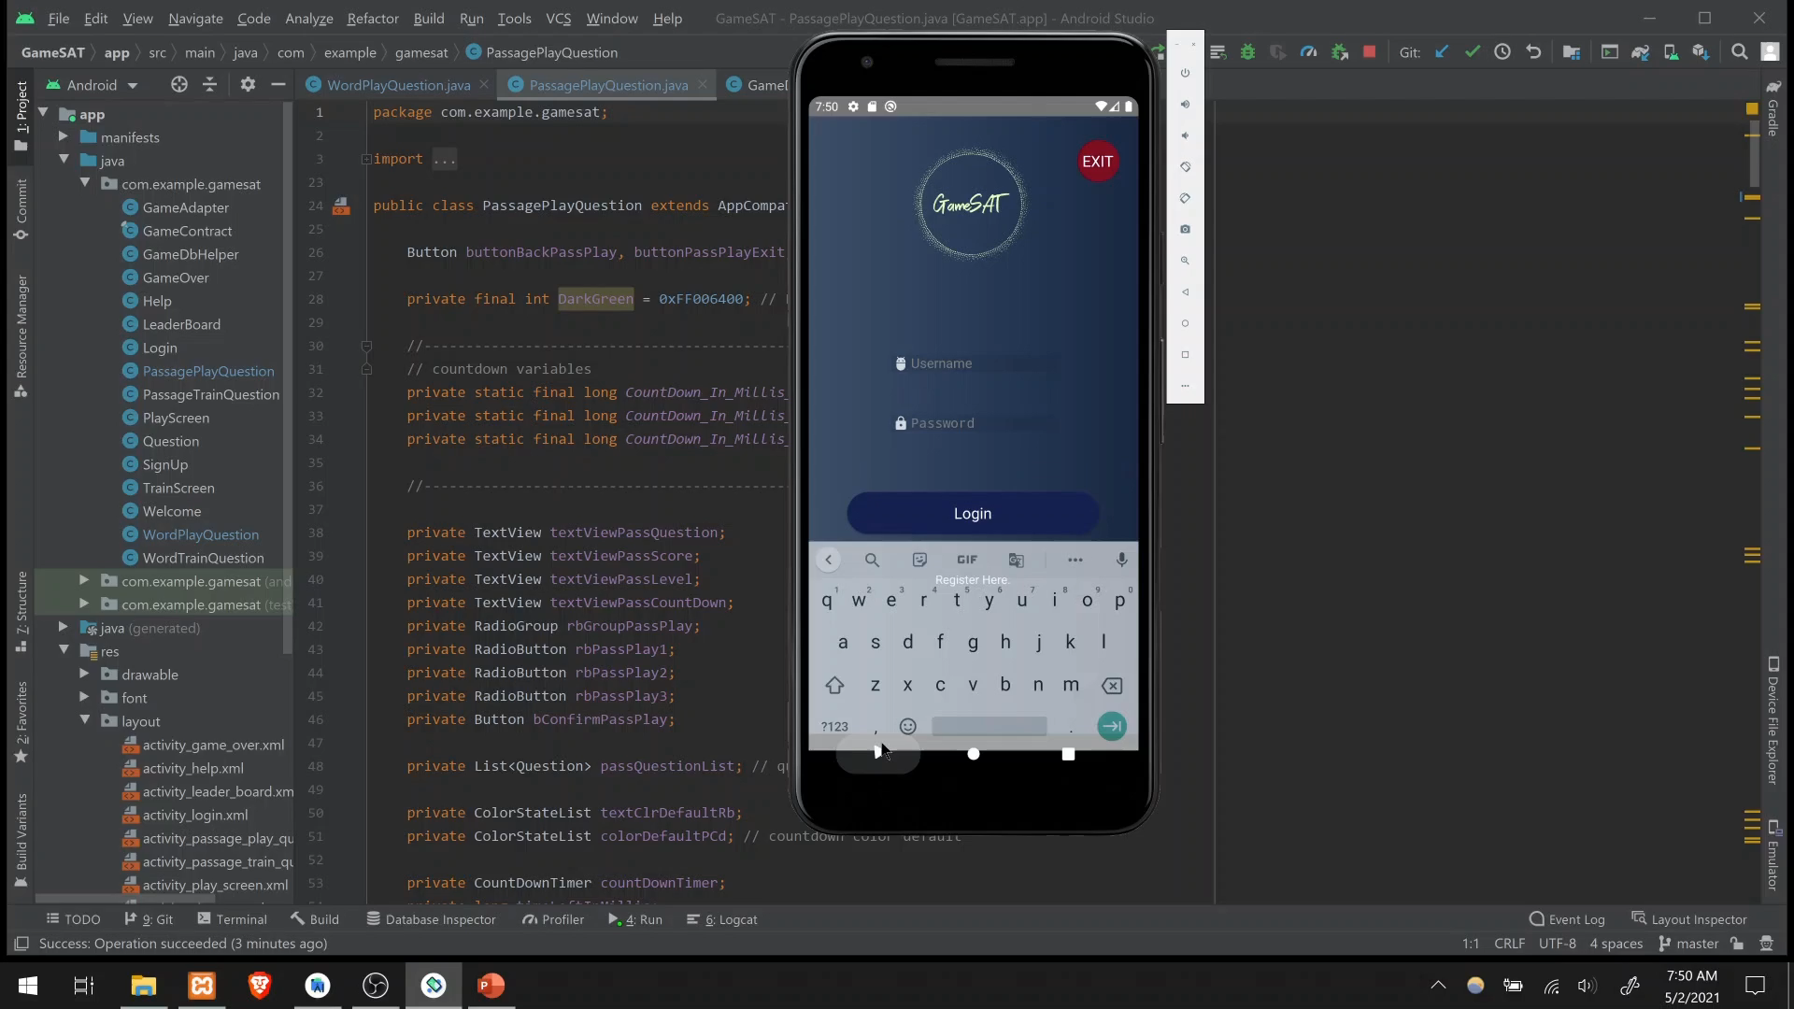

Slide 12
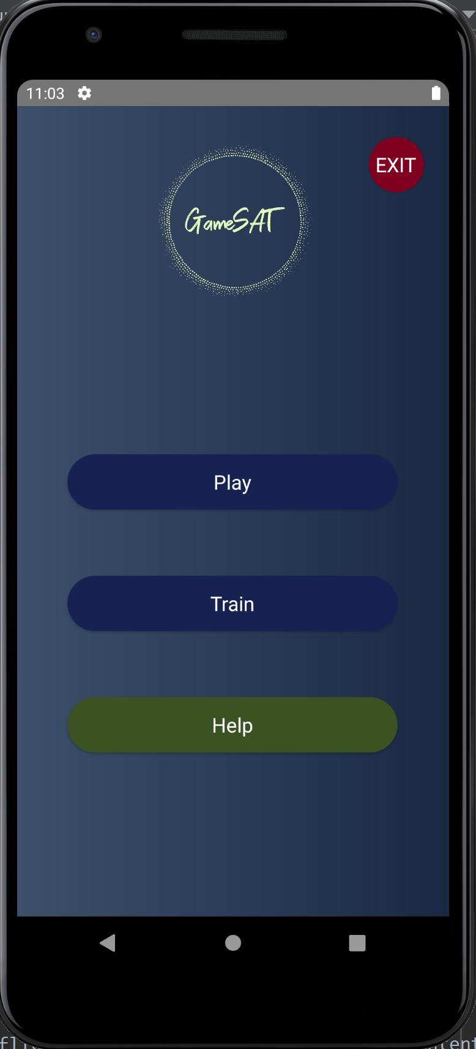
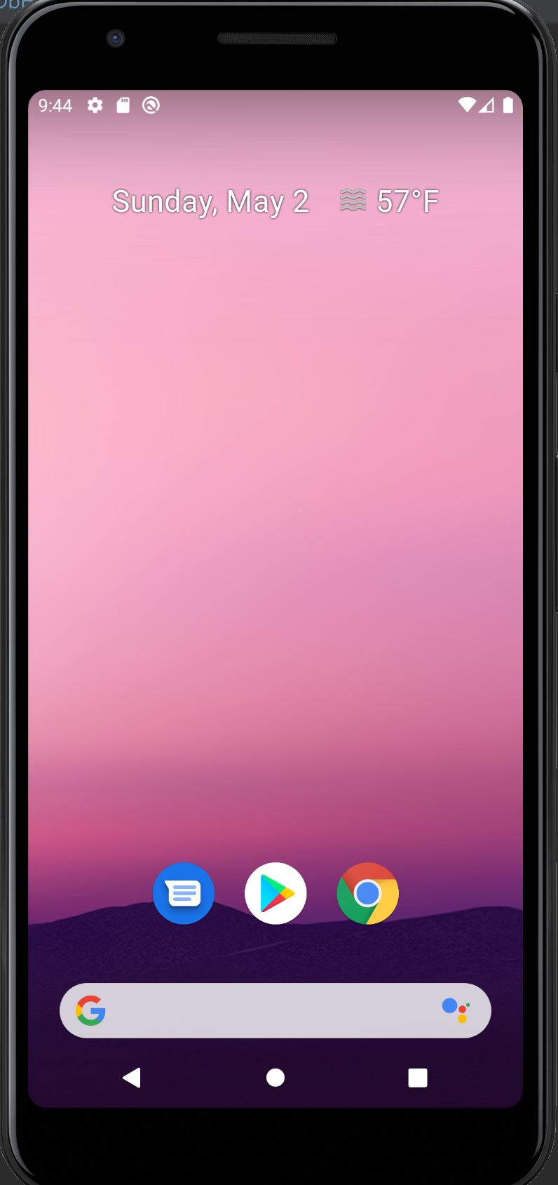
Exit from Welcome Screen
User enters Username and Password
User selects Login.
User selects the EXIT button.
The game ends, the app resources are released.

Slide 13
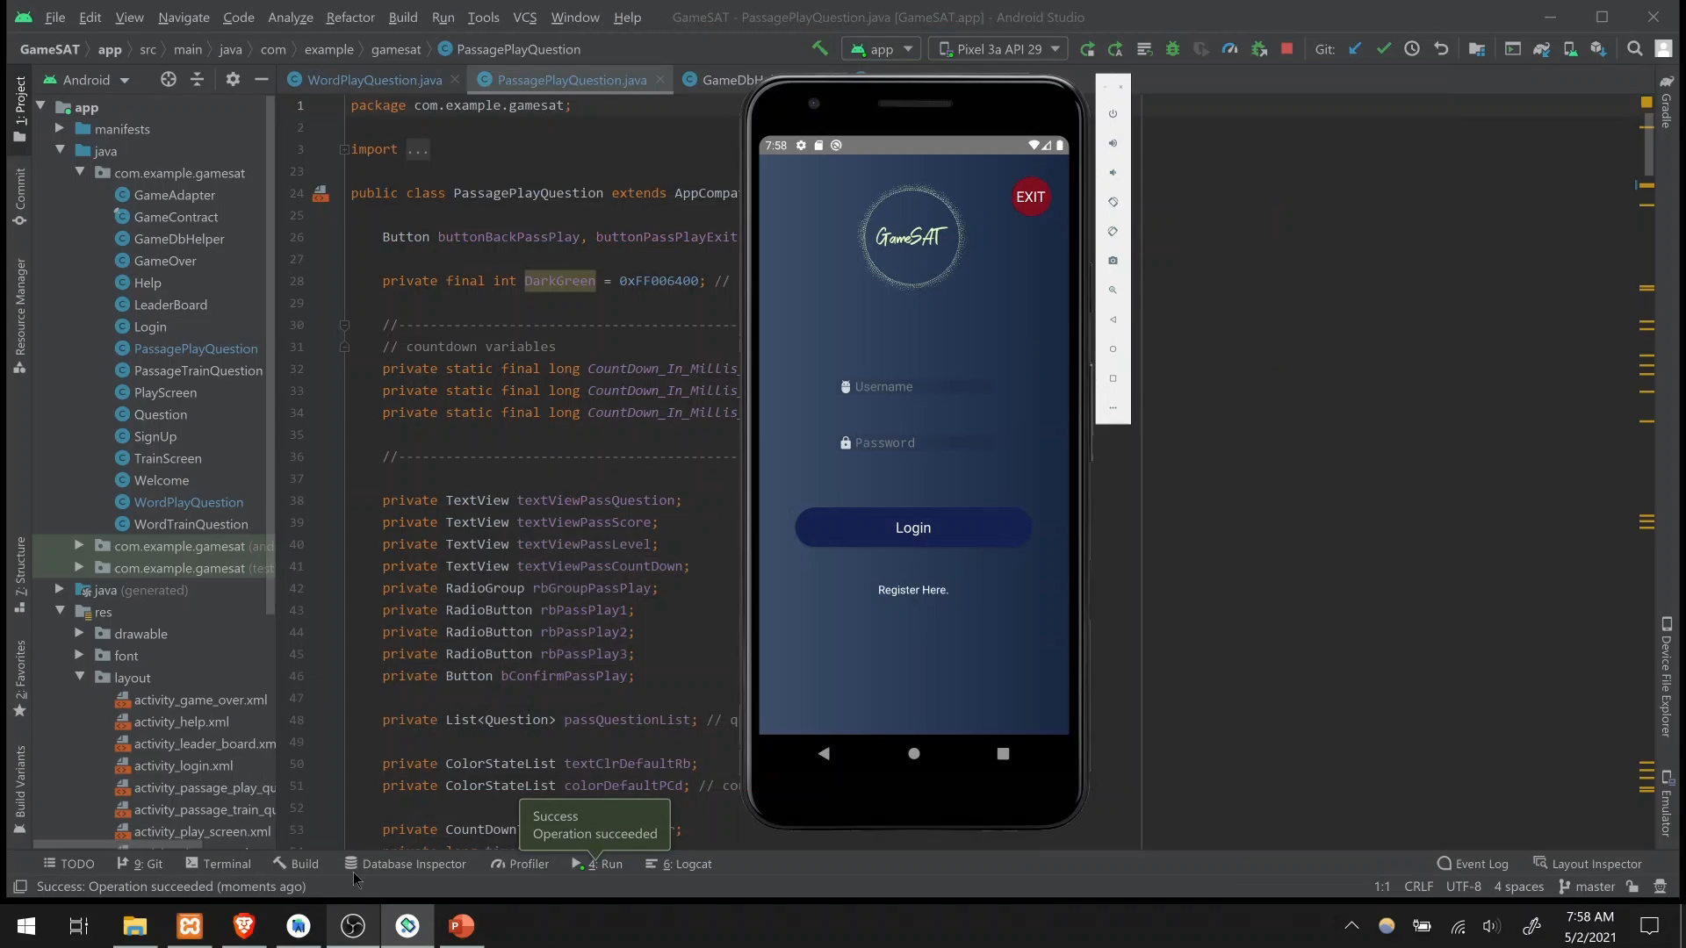

Slide 14
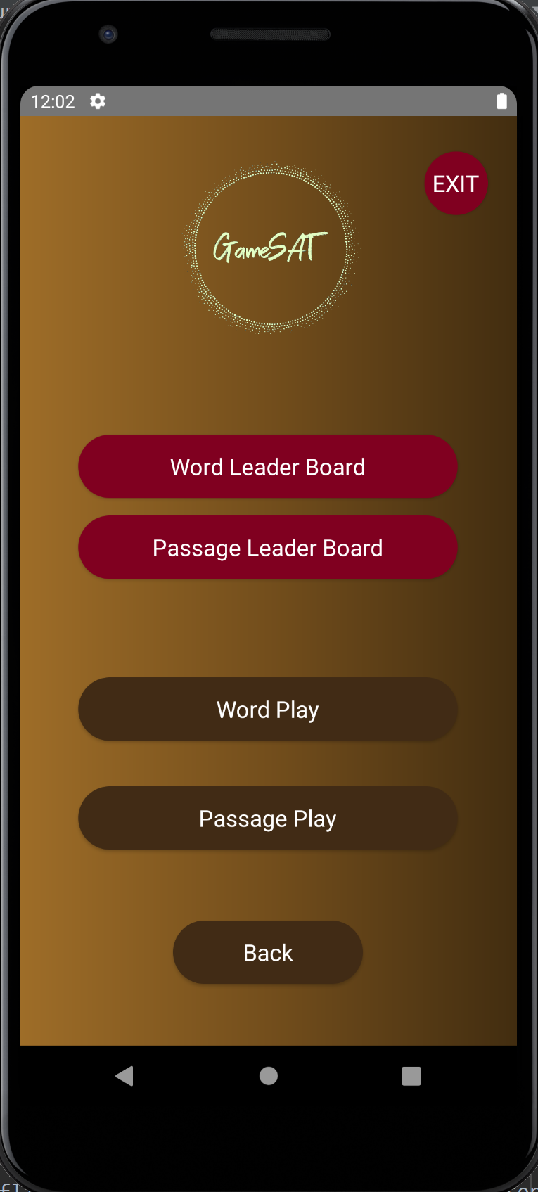
Word Play
User selects Play.
User selects Word Play.
User starts playing the Word game by making selections.
Each selection stops the timer.
After a selection, the correct answer is revealed.
Next moves the user to the next question.
The user's score is changed based on the choice of the previous question.
The Back button can lead to loss of progress.

Slide 15
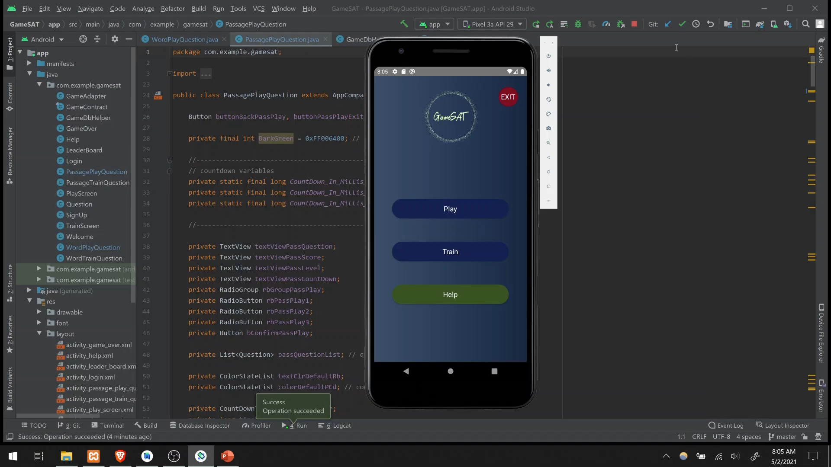

Slide 16
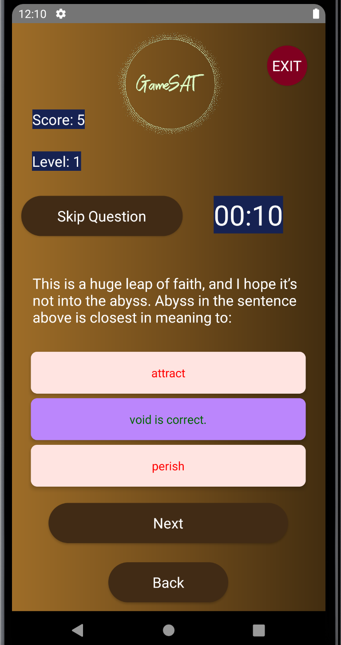
Passage Play (Increase)
User selects Play.
User selects Passage Play.
User starts playing the Passage game by making selections.
Each selection stops the timer.
The correct answer is revealed.
Every correct selection increases the score by one.
Next moves the user to the next question.
The Back button can lead to loss of progress.

Slide 17
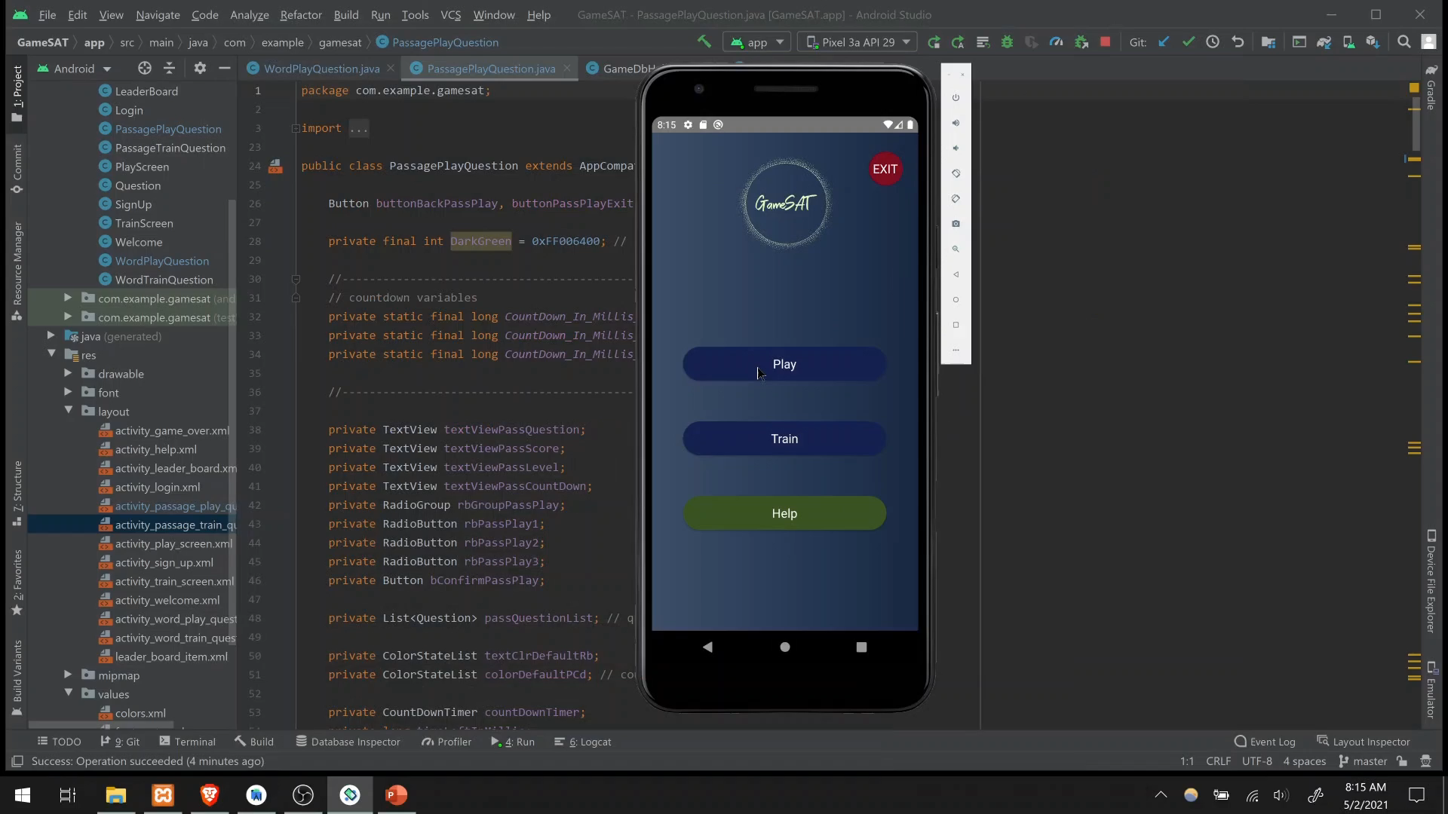

Slide 18
Passage Play (Decrease)
User selects Play.
User selects Passage Play.
User starts playing the Passage game by making selections.
Each selection stops the timer.
The correct answer is revealed.
The user's score is decreased by one.
Next moves the user to the next question.
Whenever score becomes 0 the game stops
The Back button takes the user to the Play Screen.

Slide 19


Slide 20
Timer Goes Out (no selection)
User selects Play.
User selects Passage Play.
User starts playing the Passage game but makes no selections.
The Timer runs out.
The correct answer is revealed.
Next moves the user to the next question.
The user's score is decreased by one.
The Back button can lead to loss of progress.

Slide 21
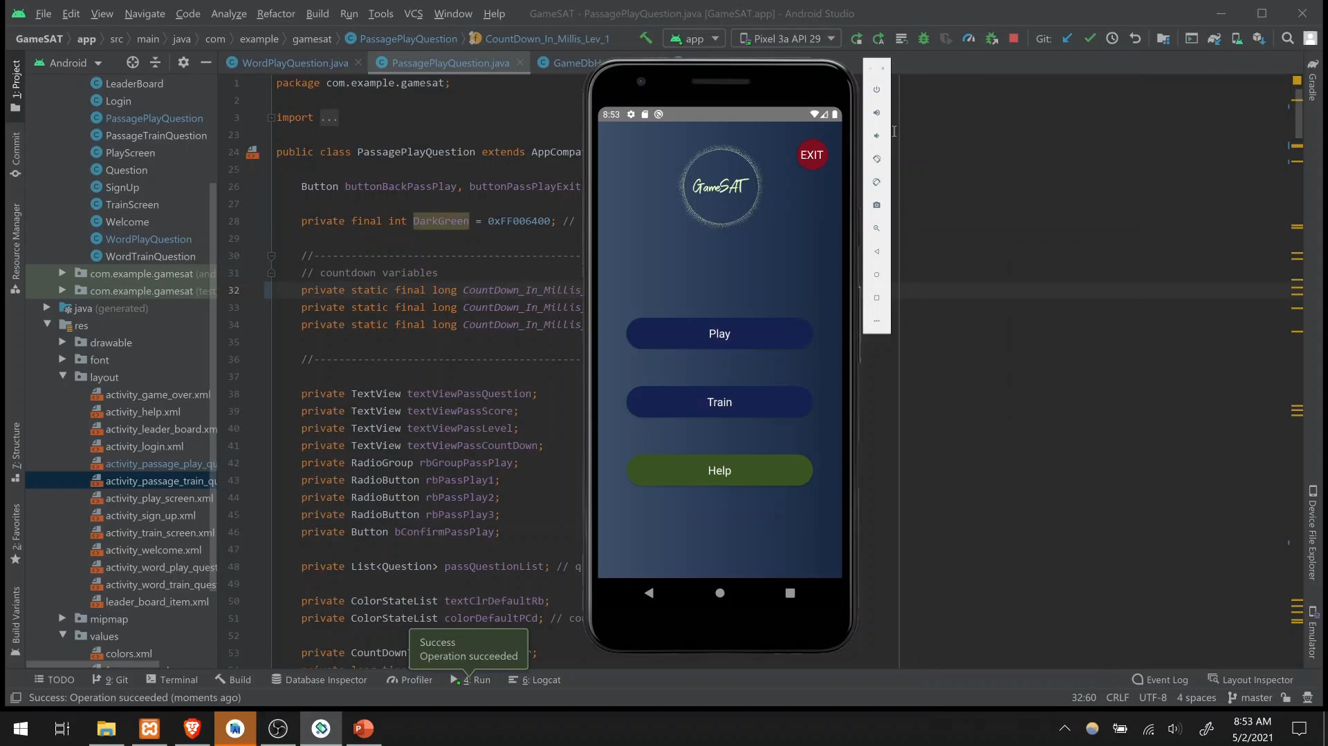

Slide 22
Timer Goes Out (correct selection)
User selects Play.
User selects Passage Play.
User starts playing the Passage game.
User selects the correct choice but does not confirm it.
The Timer runs out.
The correct answer is revealed.
Next moves the user to the next question.
The user's score is increased by one.
The Back button can lead to loss of progress.

Slide 23
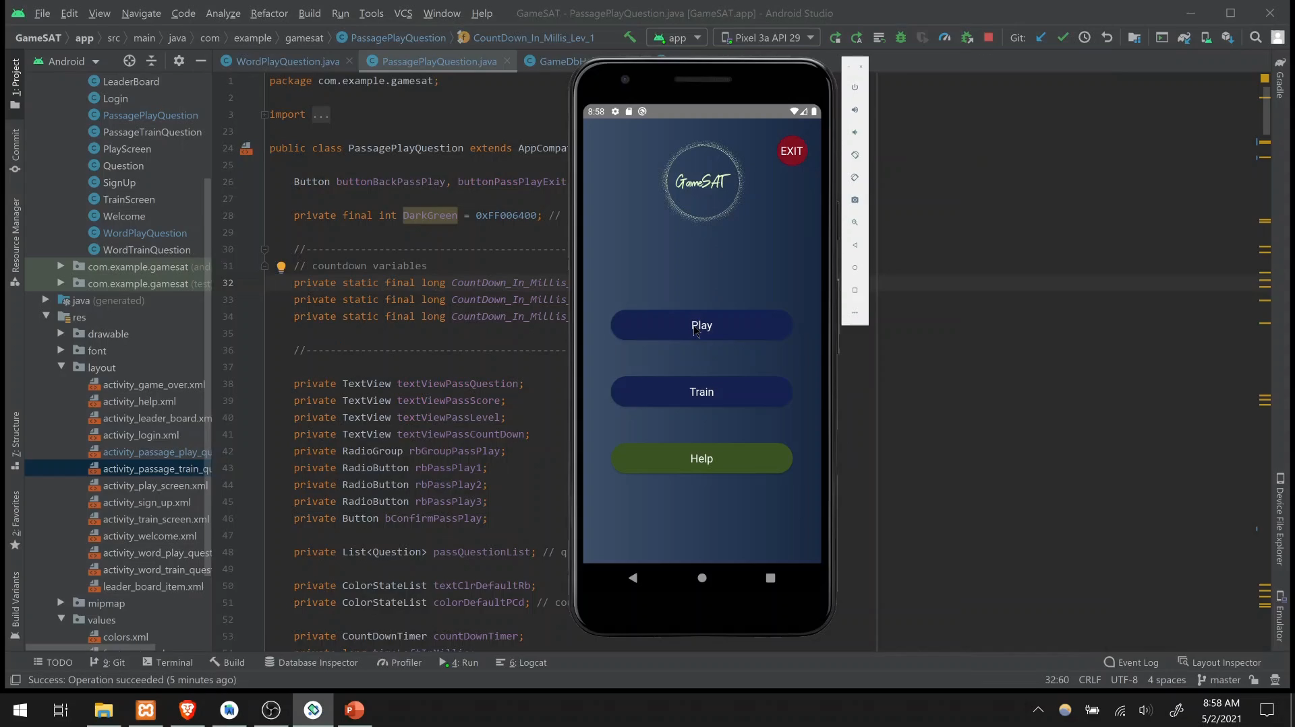

Slide 24
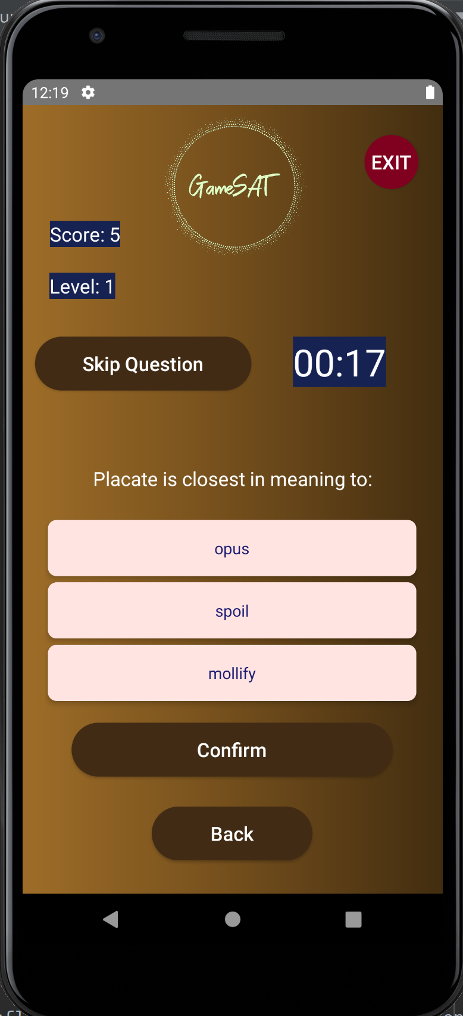
Word Leader Board
User selects Play.
User selects Word Play.
User starts playing the Word game by making selections.
Each selection stops the timer.
Every correct selection increases the score, and the correct answer is revealed.
Next moves the user to the next question.
Whenever score becomes Maximum the game stops, and the user's time and username is recorded.
The Back button can lead to loss of progress.

Slide 25
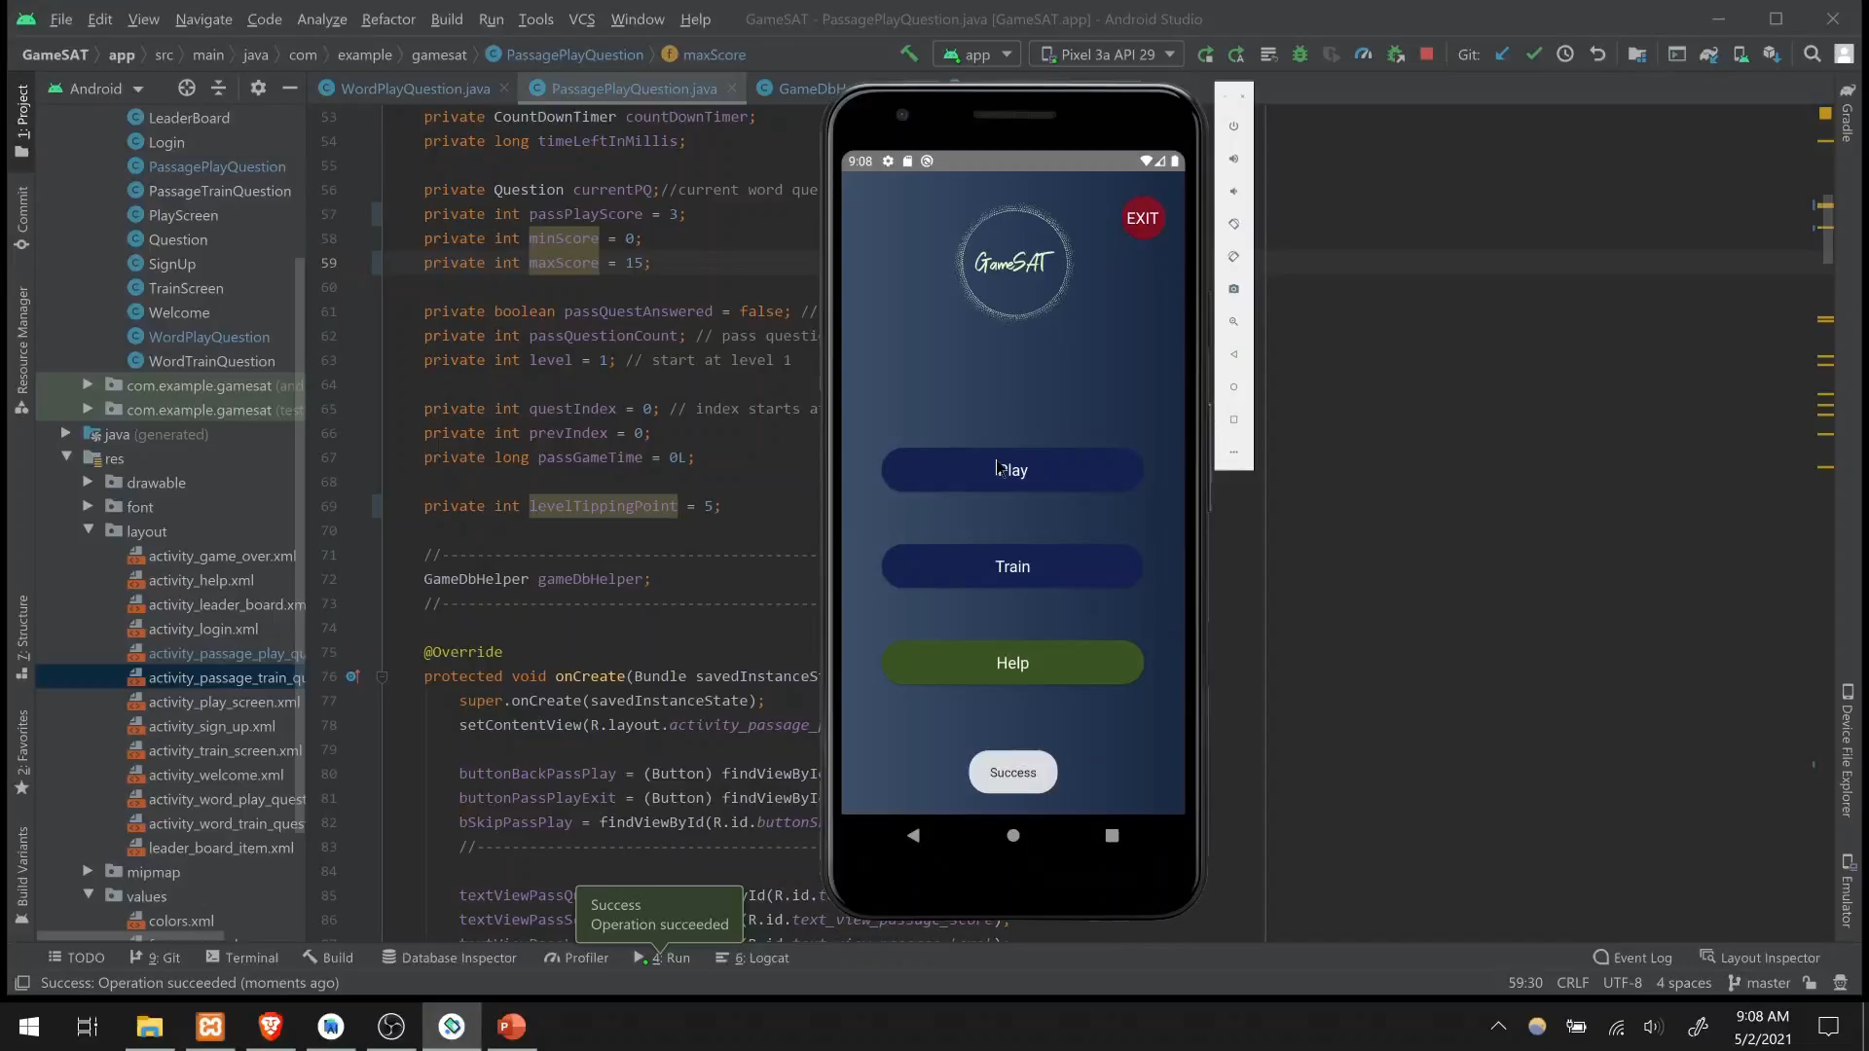

Slide 26
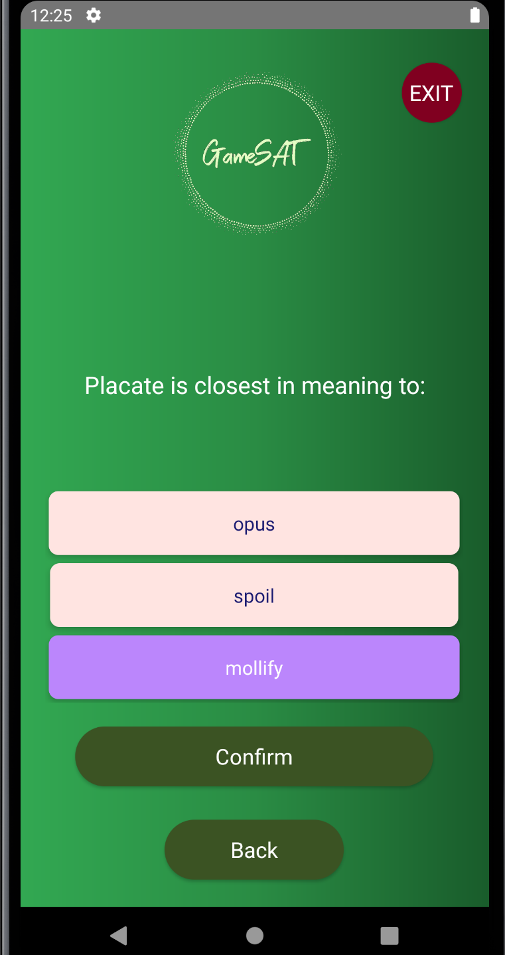
Word Play to Word Train
User selects Play.
User selects Word Play.
User Skips a word.
The Skipped question is recorded.
User presses the Back button to go to the play screen.
User presses the Back button to go to the Welcome Screen.
User selects Train.
User selects Word Train.
The Skipped question is presented twice in a row.
Upon selecting the correct answer twice, a new question is displayed.

Slide 27
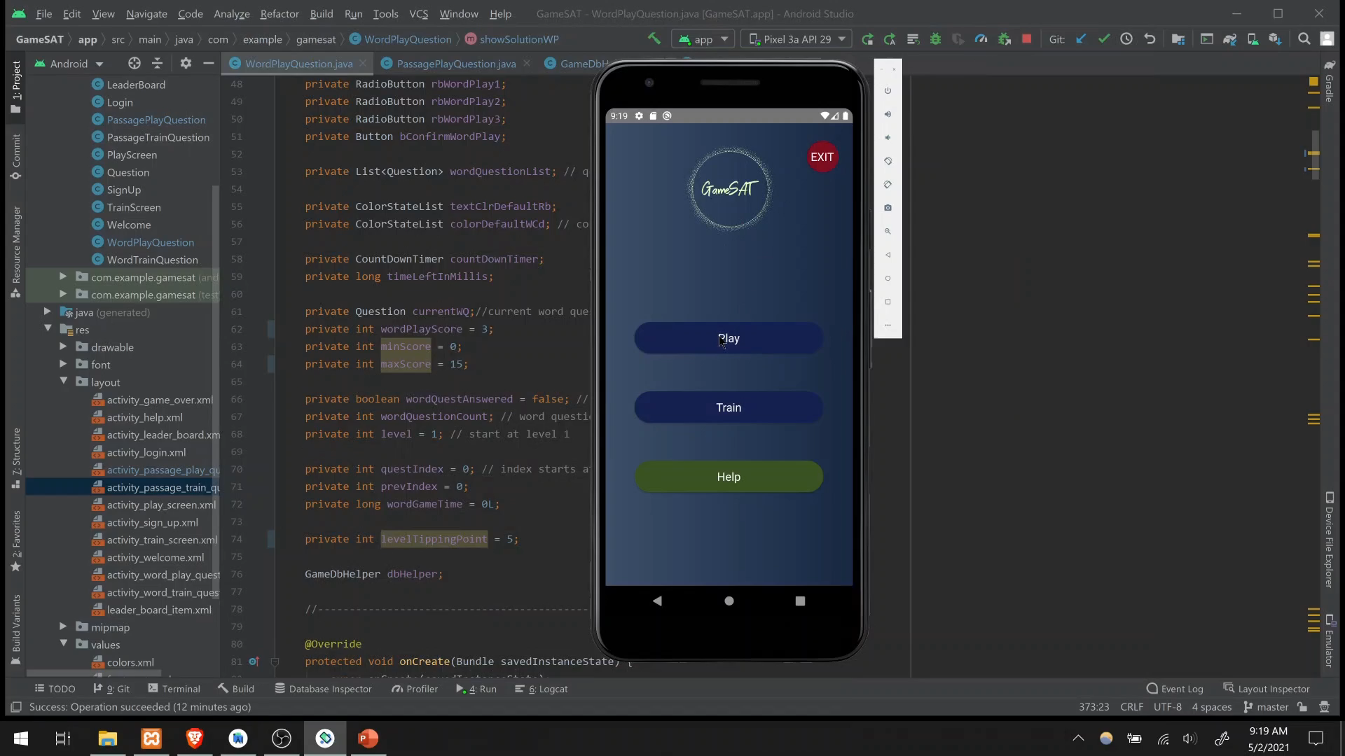

Slide 28
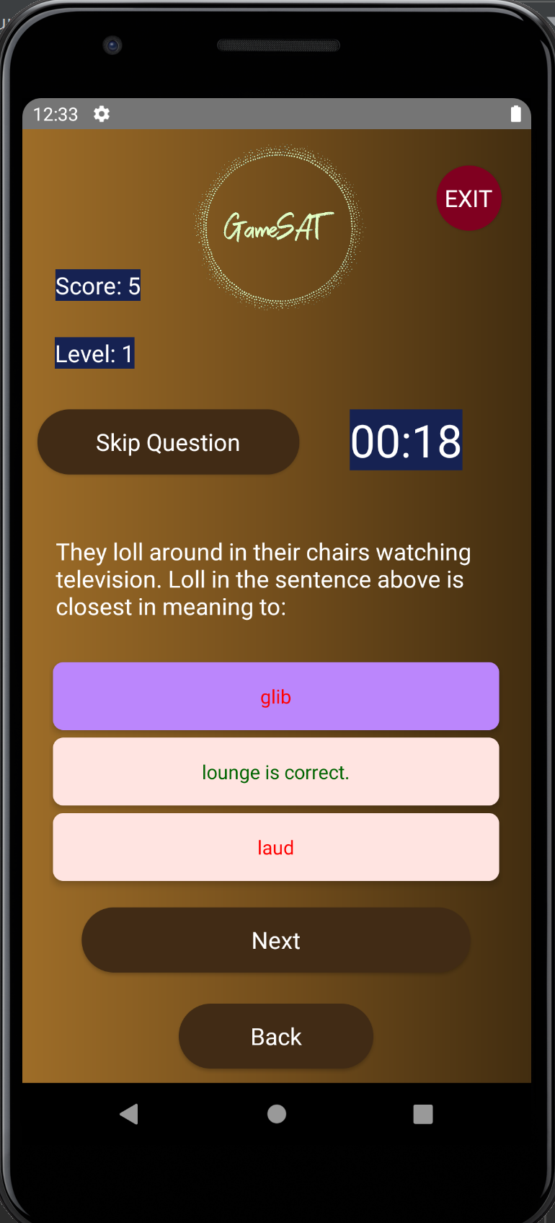
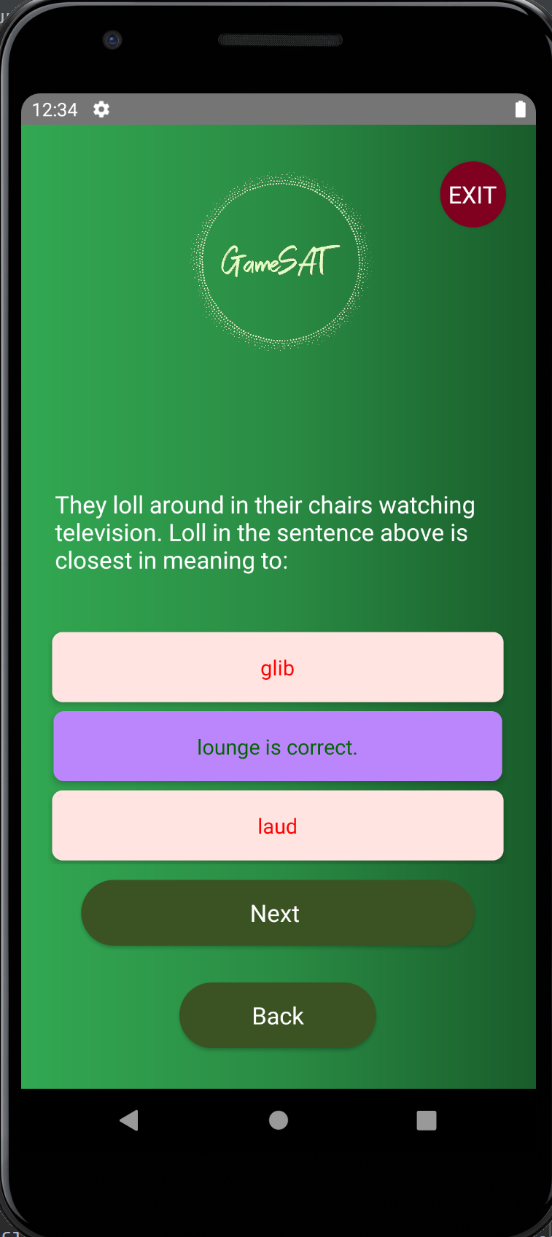
Passage Play to Passage Train
User selects Play.
User selects Passage Play.
User incorrectly selects a choice.
The timer stops and the correct choice is revealed.
The incorrect question is recorded.
User presses the Back button to go to the play screen.
User presses the Back button to go to the Welcome Screen.
User selects Train.
User selects Passage Train.
The missed question is presented twice in a row.
The user correctly selects the answer choice twice, a new question is displayed.

Slide 29


Slide 30

Challenges

Slide 31

Implementation Issues
Android Studio:
SQL integration not always optimal.
Android team recommendations not always efficient.
SQL integration is situation dependent.

Slide 32

Other Challenges
Software:
Novice in Android Development.
Novice in php and global database integration.
Novice in SQL and its integration into Android.

Slide 33
References
https://github.com/VishnuSivadasVS/Advanced-HttpURLConnection
https://www.majortests.com/gre/wordlist.php
https://www.youtube.com/watch?v=X8oD4q3XtQQ
Introduction To The GRE. (n.d.). Retrieved January 29, 2021, from https://crunchprep.com/beginners-guide-to-gre/introduction-to-gre
GRE Volumes by Country. Retrieved January 29, 2021, from https://www.ets.org/s/gre/pdf/gre_volumes_by_country.pdf
Nearly 2.2 Million Students in the Class of 2020 Took The SAT At Least Once. (n.d.). Retrieved January 29, 2021, from https://newsroom.collegeboard.org/nearly-22-million-students-class-2020-took-sat-least-once#:~:text=9%2F9%2F2020-,Nearly%202.2%20Million%20Students%20in%20the%20Class%20of,The%20SAT%20At%20Least%20Once&text=New%20York%E2%80%94Nearly%202.2%20million,Assessments%20Program%20Results%20released%20today.
“Why Use Games to Teach?” Games, 7 May 2018, https://serc.carleton.edu/introgeo/games/whygames.html
University, Stanford. “Using Games as an Educational Tool Provides Opportunities for Deeper Learning, Panelists at Stanford Event Say.” Stanford News, 1 Mar. 2013, https://news.stanford.edu/2013/03/01/games-education-tool-030113/
“Digital Pedagogy - A Guide for Librarians, Faculty, and Students: Game Based Learning - Why Do It: Benefits, Challenges.” Research Guides, https://guides.library.utoronto.ca/c.php?g=448614&p=3505475
https://codinginflow.com/tutorials/android/quiz-app-with-sqlite/part-1-layouts
https://gre.economist.com/gre-advice/gre-vocabulary/which-words-study/most-common-gre-vocabulary-list-organized-difficulty

Slide 34

Thank You

